Slide 1
Native Message

Slide 2
NATIVE MESSAGE TYPES
NCR ATM – NDC/NDC+
DIEBOLD ATM – DDC

Slide 3
Overview
Central Application
1-Request
X
P
N
E
T
Device
Handler
2-Response
Terminal
Authorization
Host
Interface

Slide 4
Message Types
Each message has two part identifier – Message Class and Sub-class
Message Type Direction Class Sub-Class
Transaction Request To Central 1 1
Unsolicited Status To Central 1 2
Solicited Status To Central 2 2
TM-Alert Message To Central 3 -
Software Management Installation Message To Central 4 1
Exit To Host To Central 5 1
Terminal Commands To terminal 1 -
Data Load Commands To terminal 3 1 or 3
Interactive Transaction Response To terminal 3 2
Transaction Reply To terminal 4 -
TM-Alert Message To terminal 5 -
Host To Exit To terminal 7 1

Slide 5
Message Types
Messages To Central From The Terminal:
Transaction Request Messages
The terminal sends a Transaction Request message to Central after it has gathered the transaction details from the cardholder. The Transaction Request is issued by a Transaction Request state.
Solicited Status Message
The terminal always sends a Solicited Status message in a response to any command from Central. The information in the status message depends on the command. It can range from a simple Ready status, indicating the command was completed as directed, to detailed information on the status of a device or the values of tallies, error logs, supply counters, and so on.
Unsolicited Status Message
The terminal sends an Unsolicited Status message to Central to report one of the following conditions: An external event, such as an attack on the terminal has taken place, A device error, A supplies problem.
TM-Alert Messages
Messages from TM-Alert which are intended for Central are tagged with a header identifying them as TM-Alert messages, before they are transmitted to Central.
Software Management Installation Messages
There are three messages relating to Software Management installation activity.
Exit To Host Messages
These messages allow an Exit to send data to the Host.

Slide 6
Message Types
Messages From Central To The Terminal:
Transaction Reply Command
Central should send this in response to a Transaction Request
message from the terminal. This Transaction Reply tells the terminal
how to complete the transaction.
Interactive Transaction Response
This message allows you to send screen data to the terminal to
prompt the cardholder for more information and enable a keyboard
to allow the cardholder to enter the information.
Load Messages
These send configuration data to the terminal.
Terminal Commands
These are used to control and monitor the terminal and solicit a
response depending on the command.
TM-Alert Messages
These are used for communications between Central and TM-Alert
running on NDC+ terminals.
Host To Exit Messages
These messages allow you to send data to an Exit. They may solicit a
response, depending upon the Exit.

Slide 7
Message Types
Messages From Central To The Terminal:
Transaction Reply Command
Central should send this in response to a Transaction Request
message from the terminal. This Transaction Reply tells the terminal
how to complete the transaction.
Interactive Transaction Response
This message allows you to send screen data to the terminal to
prompt the cardholder for more information and enable a keyboard
to allow the cardholder to enter the information.
Load Messages
These send configuration data to the terminal.
Terminal Commands
These are used to control and monitor the terminal and solicit a
response depending on the command.
TM-Alert Messages
These are used for communications between Central and TM-Alert
running on NDC+ terminals.
Host To Exit Messages
These messages allow you to send data to an Exit. They may solicit a
response, depending upon the Exit.

Slide 8
Message Types
NDC specifies the fields within each type of message. The fields depend on the type of message. Individual fields within the message are separated by a field separator, and related groups of fields are separated by a group separator.
Transaction Request Message Structure:
Field Number of Mandatory /Optional Description
Characters
a Var M Header. Protocol-dependent.
b 1 M Message Class. The message class is:
‘1’ - Unsolicited message
c 1 M Message Sub-Class. The message subclass is:
‘1’ - Transaction Request message
FS 1 M Field Separator.
d 3 or 9 M Logical Unit Number (LUNO). This number is defined in a field transmitted to the terminal in a Configuration
Parameters Load message. The default number is 000. If
the data security feature is configured, an additional six
characters are present which contain the security terminal
number. See the NDC Supervisor’s Reference Manual for
your application for details.
FS 1 M Field Separator.

Slide 9
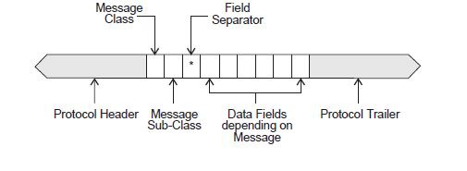
Message Structure
All NDC messages have the following structure:

Slide 10
AUDIT Message
NDC/DDC message
1: 11 - Transaction request
2: 002 - LUNo
5: 1 - At top of receipt
2 - Message Coordination 'Number'
6: ;4713220000170153=13062261181671200000?
8: ABC C B - Opcode. Card then cash. Wdl from sav acct.,
9: 000000001500 - Amount
10: 9=581343006><2?0 (9D581343006EC2F0) - PIN Block
14: 2: Previous Transaction Status
0763 - Last tran seq no.
1 - Last status sent - Good completion sent
00001 00002 00000 00000 - Last notes disp counts
15: 5: Smartcard Data
CAM - assumed NCR format
CAM Flags: 0004
Easy Entry proc not init
57 Trk2 Equiv Data : 13 4713220000170153D13062261181677600000F
5A Appl PAN : 08 4713220000170153
5F34 Appl PAN Seq Number : 01 00
5F24 Appl Expiry Date : 03 130630
...........

Slide 11
AUDIT Message
NDC/DDC message
1: 4 - Transaction reply
2: 002 - LUNo
4: 123 - Next state -
5: 1 2 0 1 Notes
6: 0764 - Tran serial number
A - Eject card, dispense and print
040 - Transient Screen No.
Screen updates
Screen No : 075
Screen Data : .@@
7: 2 - Message coordination 'number'
0 - Return card
1 - Journal print only
.525/11/11 11:07 00000002...5XXXXXXXXXXXX0153...4FLACQ BRANCH
..
1 - Journal print only
.4*RECORD NO..? 764..4*RETRAIT.6 MUR1500.00..4*FR.401020043229..
.4*LEDGER BAL.6 MUR15257.29..4*AVAIL BAL .6 MUR15257.29..4
.4
AU REVOIR ET A BIENTOT..4 POWERED BY PEX.
8: 5: Smartcard data
CAM
91 Iss Authent Dat-ARPC : 0A ED446D57CE2F273C3030
8A Auth Resp Code : 02 3030
--- End of Message ---

Slide 12
Internal Message

Slide 13
Message Types
STM - ATM Standard Internal Message
PSTM - POS Standard Internal Message
ATM DH
AUTH
HISO
STM
STM
STM
POS DH
PSTM
VISA/MDS
PSTM

Slide 14
Important Fields in STM/PSTM
TYP - Message type. 0200/0210/0215 etc
PROD-ID - 01 = ATM, 02 = POS
TRAN-CDE - 10 = Withdrawal, 20 = Deposit, 30 = Bal Inq etc
FROM-ACCT-TYP – 01 = Checking, 11 = Saving, 31 = Credit
TO-ACCT-TYP
STAT – The status of message at system level. 00 = No Error,
01 = Processing Error, 02 = Security Failure Error etc
NOT-ON-US-FLAG – 0 = On Us, 1 = Not On Us
ORIG-PROC-NAME - The symbolic name of the BASE24-atm
process that received the transaction
ORIGINATOR - Indicates where the transaction originated.
1 = Device, 2 = DH, 3 = AUTH, 4 HISO,
5 = HOST, 6 = Interchange Process,
7 = Interchange
RESPONDER - Indicates where a response message (0210) was generated.

Slide 15
Important Fields in STM/PSTM
TRAN-DAT - The date (YYMMDD) the transaction was initiated
TRAN-TIM - The time (hhmmsstt) the transaction was initiated.
TERM-ID - Identifies the originating terminal. This field is set by
Device Handler, Host Interface, or Interchange Interface
process.
SEQ-NUM - The sequence number associated with this
transaction.
TRACK2 - Track2 data from card.
RVSL-CDE - A code indicating the reason for the reversal or
adjustment.
PIN - The PIN entered by the cardholder initiating the
transaction.
AMT-1 - The transaction amount requested.
RESP - Response code.
......

Slide 16
AUDIT Message
Rec 61 P1A^N50 -> P1A^AUTH1 Len 1250 f--- 25/11 11:07:58.03
543158
STM message
Type: 0200 PC: 10 11 00 RC: 000 Seq: 764 Card: 4713220000170153
[0200][01] DPC[0000] TCode[101100][00][0][P1A^N50 ][0000000000000000]
Orig[1] Resp[0] Excp[0] CardLN[0000] RcvInst[00000000000] CardFI[0000]
Shr[B ] TranDtTm[111125][11075801][0] TimeOs[ 0]
Post[111125] Acq[000000] Iss[000000] TermFI[BONE] Term[00000002 ]
TermLN[PRO1] Brch[ ] Regn[MUR ] Seq[764 ] [0][0][0][0]
Trk2[;4713220000170153=13062261181677600000?0] PINOs[0000000000000000] Mbr[000]
TermType[22]OCrncy[480]ACrncy[000]SCrncy[000]ACvRate[00000000]SCVRate[00000000]
CvDtTm[ ]Acq[00000467755]MultA[4] Rvsl[00]From[0000000000000000000][0]
To[0000000000000000000] PIN[9D581343006EC2F0] Sz[16] Tries[0]
Amts[ 150000 ][ 0 ][ 0 ][ 0]
AvDepType[0] DepType[0] Compl[0] Resp[000] App'd with balances
TermLoc[FLACQ BRANCH ] Owner[BANK ONE ATM ]
City[MAURITIUS ]State[MUR]Cntry[MU]Orig[000000000000][0000][00000000][0000]
Allwd[4] Trace[000000] TermState[00] Cnty[000] Cntry[480] [0000000000000000]
PriDest[0000000000000000] Alt[0000000000000000] Auth[0000000000000000] [0]
[00000000000] SvFrom[00] SvTo[00] PostCode[123456 ]
[00000000000000000000000000000000000000] Fmt[0] PrntSz[080]
StmpIn[070758029] Out[000000000] Re[000000000] CardAccID[00000000000]
FwdInst[00000000000] CardIssID[00000000000] AuthID[000000] Trk3[000000000000000
0000000000000000000000000000000000000000000000000000000000000000000000000000000
0000000000000] MicrData[0000000000000000000000000000000000000000000][0]
Number of tokens: 8 Total length: 378
ID Len Data
-- --- ----------------------------------------------------------------------
B4 ATM/POS EMV status
20: 05151000000400 0
B2 ATM/POS EMV request data
80: {............b.J.l............|.........%.<.......... ................
..........
B3 ATM/POS EMV discretionary data
44: A. `@. ..............................
03 ATM Release 5.0
6: 000003
B7 ATM/POS TLF data
86: ........ 1
..
B8 ATM/POS Txn profile
34: ATM
B9 ATM/POS Txn description
60: ISO011000
--- End of Message ---

Slide 17
External Message

Slide 18
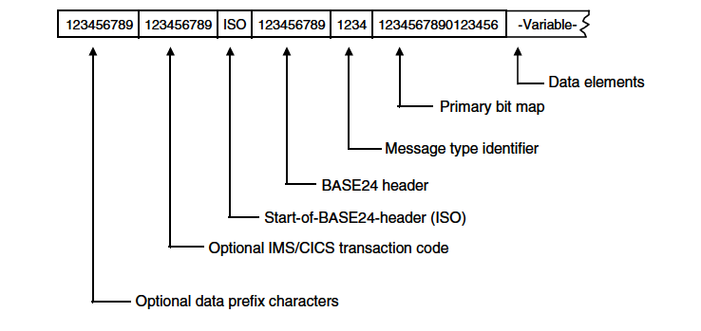
Message Structure

Slide 19
Message Header
Product Indicator – 00 = Base, 01 = ATM, 02 = POS etc.
Release Number - Indicates the release of the BASE24
product with which this message is
Associated. Length = 2.
Status - Message status.
Originator Code - 0 = undetermined, 1 = device , 2 = DH,
Responder Code - 3 = AUTH, 4 = HISO, 5 = HOST etc.

Slide 20
Message Type Identifier
This is a 4 digit numeric field, whose each digit starting from the left indicates - ISO 8583 version, the message class, the message function, and the message origin. E.g. 0200, 0100, 0400 ...
1st Position – Version Number
0XXX = ISO 8583:1987, 1XXX = ISO 8583:1993
2XXX = ISO 8583-1:2003
2nd Position – Message Class
01XX = Authorization messages
02XX = Financial transaction messages
03XX = File update messages
04XX = Reversal messages
08XX = Network management messages
3rd Position – Message Function
XX00 = Request , XX10 = Request response , XX20 = Advice
XX30 = Advice response, XX40 = Notification
4th Position – Message Source
XXX0 = Acquirer , XXX1 = Acquirer repeat
XXX2 = Issuer , XXX3 = Issuer repeat

Slide 21
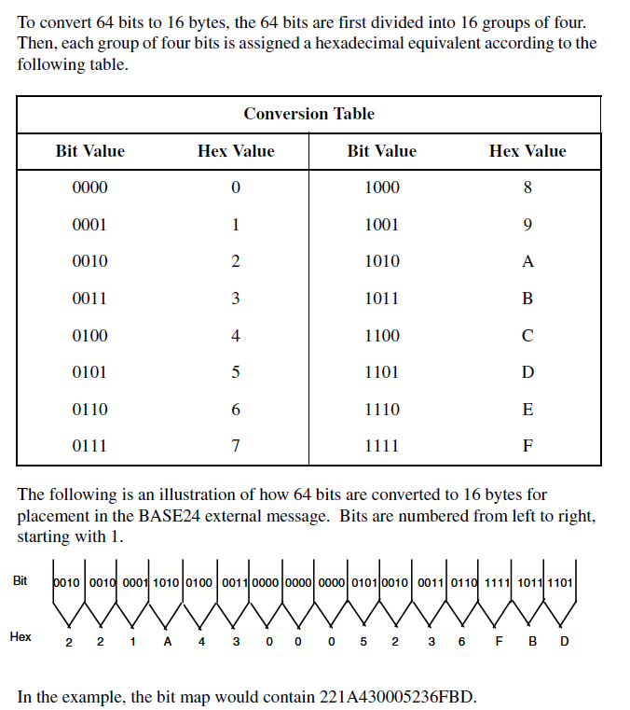
Primary Bitmap
The primary bit map is a 16-position field required in all messages. It represents 64 bits of data used to identify the presence (denoted by 1 or bit on) or absence (denoted by 0 or bit off) of the first 64 data elements in the message.

Slide 22
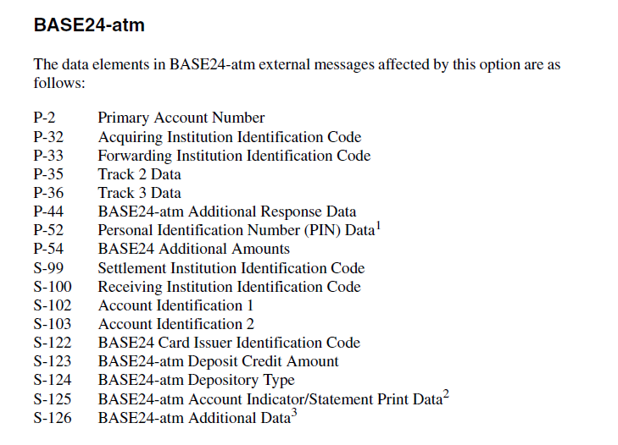
Data Elements

Slide 23
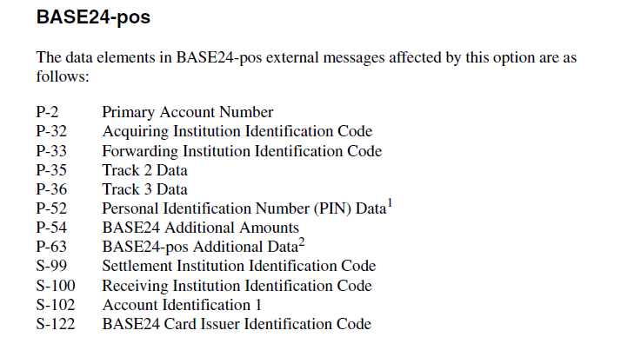
Data Elements

Slide 24
AUDIT Message
Rec 341 S1AELEC -> (dest: type %hF) Len 216 f--- i 12/06 12:53:56.18
598090
VISA message
H1 Header Length : 22
Hdr Header Follows : No
H2 Header Format : 1
H3 Text Format : 2 - Bitmapped
H4 Message Length : 216
H5 Dest Station : 967725
H6 Source Station : 000000
H7 Round Trip : 1
H8 Base1 Flags : x0010
Hdr Returned Message : No
H10 Batch No : 7
H11 Reserved : 01
H12 User Info : x00
Message Type : 0100
Primary Bitmap : 7664 6481 28E0 B816
2 PAN : 4504 78XX XXXX 0015
3 Processing Code : 01 00 00 - Withdrawal/Cash Advance
4 Transaction Amount : 20.00
6 Cardholder Billing Amount : 961.29
7 Transmission Date and Time : 12/06/yy 07:15:28
10 Cardholder Billing Conv Rate : 48.06450
11 Systems Trace Audit Number : 004224
14 Expiry Date : dd/05/18
18 Merchant Type : 6011
19 Acquiring Inst Country Code : 702
22 POS Entry Mode : 0510
25 POS Condition Code : 00 - Normal
32 Acquiring Institution ID : 476135
35 Track 2 : 450478XXXXXX0015=EEEESSSCVV
37 Retrieval Reference Number : 3163 0700 4224
41 Card Acceptor Terminal ID : ATM01
42 Card Acceptor ID : CARD ACCEPTOR
43 Card Acceptor Name/Location : ACQUIRER NAME CITY NAME SG
49 Transaction Currency Code : 702
51 Cardholder Billing Currency : 356
52 PIN : PPPPPPPPPPPPPPP
53 Security Related Control Info : 2001010100000000
60 Additional POS Information : 25
62 Customer Payment Service Fields : 40000000000000000303163261290053
63 VIP Format Private-Use : 8000000002
--- End of Message ---

Slide 25
Additional Study…
BASE24 External Message Manual
NDC+ Programmers Reference Manual
NDC+
Programmers
Reference Manual
BASE24
External Message
Manual

